Slide 1
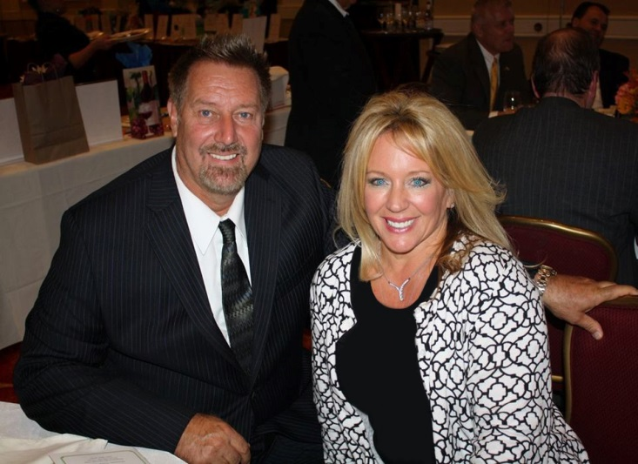
Morris County Municipal Recycling Coordinators
Overview of Food Waste Disposal Ban Legislation
Bayshore Family of Companies
Gary Sondermeyer
September 22, 2020

Slide 2
Sustainable Food Management
S-3027 Passed in July 2017: New Jersey Food Waste Reduction Act
- Goal to Reduce Food Waste by 50% by 2030
- DEP to Prepare an Implementation Plan in 1 Year
- Link: https://www.njleg.state.nj.us/2016/Bills/AL17/136_.PDF
DEP Draft Food Waste Reduction Plan Released in August of 2019
- Sector Based Approach
- Plan Being Finalized at this Time
- Link https://www.nj.gov/dep/dshw/food-waste/food_waste_plan_draft.pdf
Food Waste Recycling Act Signed by Governor on 4/14/2020 as A2371/S865
- Disposal Ban Legislation First Developed through ANJR October 2014
- Many Versions over 5 ½ Years: Version passed close to Original Scope
- Link: https://www.njleg.state.nj.us/2020/Bills/A2500/2371_R2.PDF
Other Important Food Reduction/Recycling Developments:
- A4705 Passed in May ’19, Creates New Jersey Food Waste Task Force
- DEP School Food Waste Guidelines (reduction, donation, recycling)
- DEP Food Reduction Website: https://www.nj.gov/dep/dshw/food-waste/

Slide 3
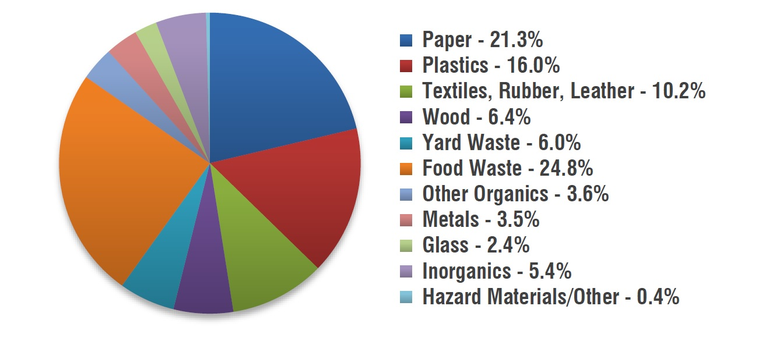
What’s Left in the Can After 30 Years of Mandatory Recycling?

Slide 4
A2371/S865 Overview
ANJR Modeled Draft off of Connecticut Legislation
New England States Are 5 Years or More Ahead of us: CT, MA, VT, RI, NYC and Philly
Disposal Ban Becomes Effective In October of 2021 – Who’s In?
- Large generators (52 Tons Per Year – a Ton Per Week)
- Facility Available within 25 road miles of a food waste facility
- Can’t pay More than 10% of Transportation and Disposal
DEP has to:
- Adopt any Needed Rules and Regulations
- Outline Recordkeeping & Reporting Obligations of Generators
- Provide Guidelines on Calculating Generation
- List Food Waste Products to Recycle and Operating Standards
Market Development Council Created - Year to Report
Procurement Requirements for State Agencies
50 Cent Host Community Benefit Authorized

Slide 5
Who Generates the Food?
Composition Estimate From NRDC:
- 43% Residential
- 26% Restaurants
- 14% Retail Supermarkets
- 9% Institutions (Hospitals, Prisons, Schools)
- 8% Food Manufacturers & Processors
Old DEP Generator Report from October 2014: Who’s Covered?
- 495 Grocery Stores
- 421 Restaurants
- 53 Hospitals
- 12 Heathcare Facilities (Nursing Homes)
- 45 Colleges & Universities
- 23 Correctional Facilities
- 893 Food Manufacturers
- 761 Food Wholesalers
- 130 Event Venues
- 61 Hotels & Motels
- 51 Resorts and Casinos

Slide 6
Other Stuff Happening!
Community Gardens Petition For Rulemaking to NJDEP
DEP Research Dollars Under Recycling Enhancement Act:
- Projects Awarded: https://www.state.nj.us/dep/dshw/recycling/summary_of_approved_2019_awardees.pdf
- Sustainable Jersey Project for Schools
- K – 12 Reduction Best Practices
- Model Food Waste Diversion & Composting Guidance
- Fund 3 Pilot Studies (like Chatham Borough)
- Develop Comprehensive Toolkit
Current Food Waste Recycling Infrastructure:
- Trenton Biogas (100,000 TPY or 450 TPD Capacity)
- Waste Management and RVSA Project (130,0000 TPY or 500 TPD)
- Organic Division Permitted – Never Built (60,000 TPY or 200 TPD)
- Kean Digester (For Solutions Company)
- Princeton University Digester
- Ag Choice Facility in Andover, Sussex County
Organics White Paper – New Jersey Climate Change Alliance, ANJR,
Composting Council and Sustainable Jersey

